Slide 1
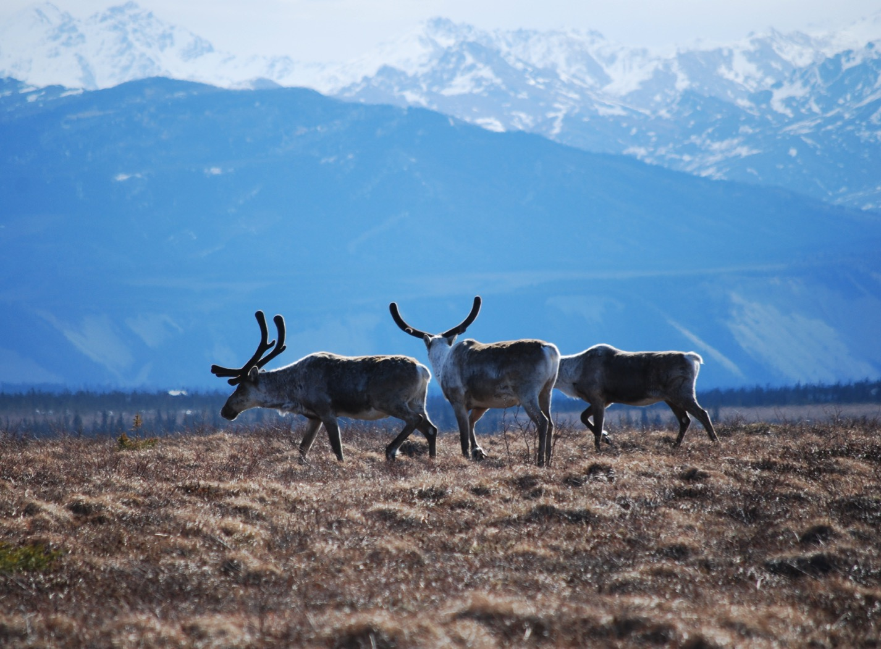
Arctic Boreal Vulnerability Experiment (ABoVE)
2017 ABoVE Airborne Campaign
17 June 2017 (DOY 168)
UAVSAR: Yukon-Kuskowim Delta
Charles Miller, Deputy Science Lead
Jet Propulsion Laboratory, California Institute of Technology
and the ABoVE Science Team For Hank Margolis, Eric Kasichke, Bruce Tagg
NASA HQ
2017

Slide 2
17 June 2017/DOY 168 Yukon – Kuskokwim Delta
Daily Summary:
C-20A (N30502) UAVSAR ABoVE CAMPAIGN (CANADA / ALASKA)
REPORT DATE: 17 June 2017
Current Status of Aircraft: GREEN
Current Status of SAR: GREEN
Current Status of PPA: GREEN
Current Deployment Location: Fairbanks, Alaska (PAFA)
Crew: Asher, Barry, Griffith, Choi, T Miller
Science Coordinator: N Pinto
Science Lead: M Moghaddam
Project Manager: Y Lou

Slide 3
17 June 2017/DOY 168 Yukon – Kuskokwim Delta
Daily Summary:
Science Flight (PAFA – PAFA #2) – 5.9 hours
Great flight
Collected 9 of 9 data lines
YK Delta, Innoko, Denali, Tanana Valley, BNZ
Flight Plan – 1135v03
Southwest Alaska: All lines were collected successfully, albeit with a couple of hiccups and re-dos.
Plus re-did lines 1 and 5 from 16 June plan:
https://uavsar.jpl.nasa.gov/cgi-bin/report.pl?planID=PLAN_1140_v02#summary

Slide 4
17 June 2017/DOY 168 72-Hour Look Ahead
All plans weather dependent
Sunday 18 June 2017 (DOY 169):
Hard down day
Monday 19 June 2017 (DOY 170):
Seward Peninsula
Tuesday 20 June 2017 (DOY 171):
Mackenzie Valley
Wednesday 21 June 2017 (DOY 172):
North Slope

Slide 5
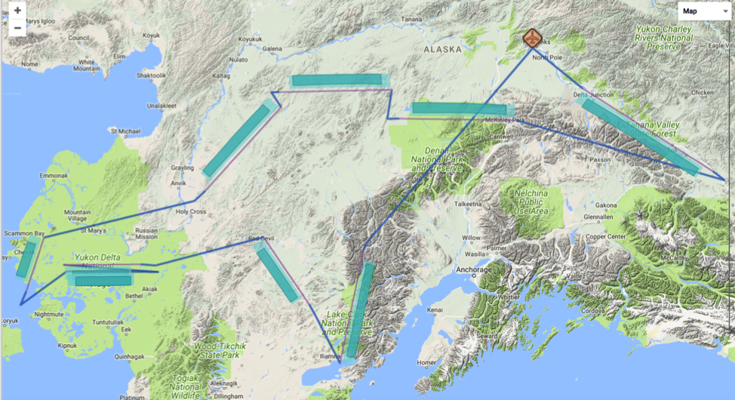
17 June 2017/DOY 168 Yukon – Kuskokwim Delta
Flight Plan ID 1135_v03.1 – Report 17066: Fairbanks AK (PAFA) – PAFA
https://uavsar.jpl.nasa.gov/cgi-bin/report.pl?planID=PLAN_17066#flightPlan
Data Acquisitions:
Line 1, ID 19205: Lake Clark
Line 2, ID 32608: S River
Line 3, ID 26905: YK Delta 1
Line 4, ID 01811: YK Delta 2
Line 5, ID 01813: YK Coast
Line 6, ID 04215: Innoko
Line 7, ID 08911: Poorman
Line 8, ID 09115: Denali
Line 9, ID 30204: Delat Junc
08911
09115
04215
30204
01811
26905
26906
32608
19205
6/17/17 flight plan & acquisition segments

Slide 6
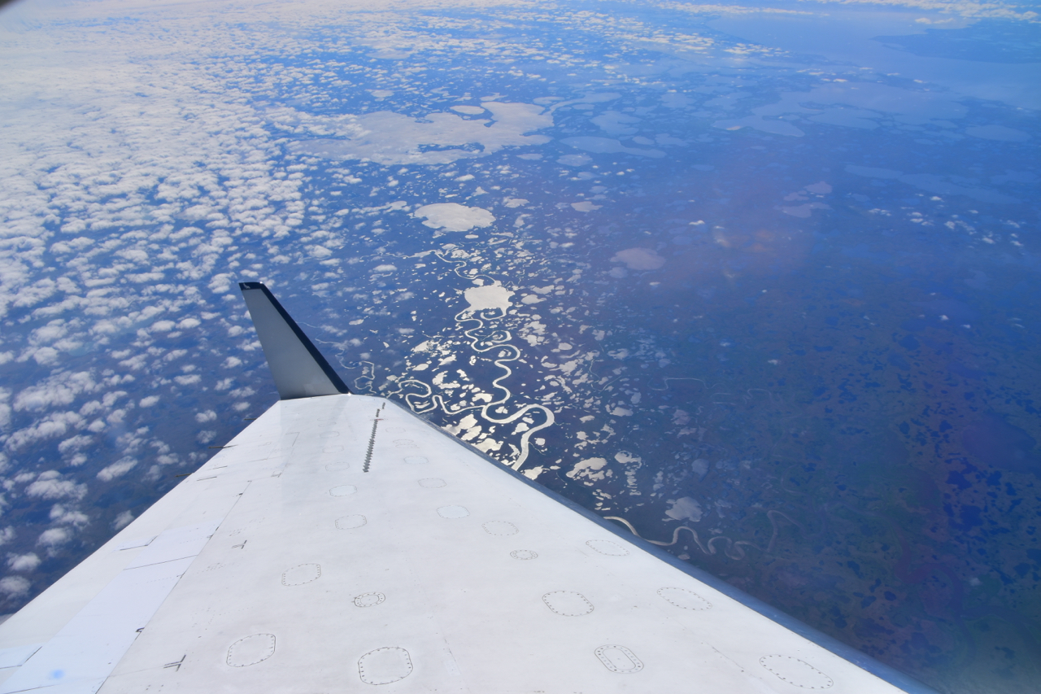
17 June 2017/DOY 168 Yukon – Kuskokwim Delta
Yukon Delta NWR near Bethel, AK
Stevens Village
Beaver
Views of Denali and western Alaska
Notes:
Yukon Delta NWR near Bethel, AK

Slide 7
17 June 2017/DOY 168 Yukon – Kuskokwim Delta
The Alaska Range over Wrangell-St Elias Natl Park
Notes:
Yukon Delta NWR near Bethel, AK

Slide 8
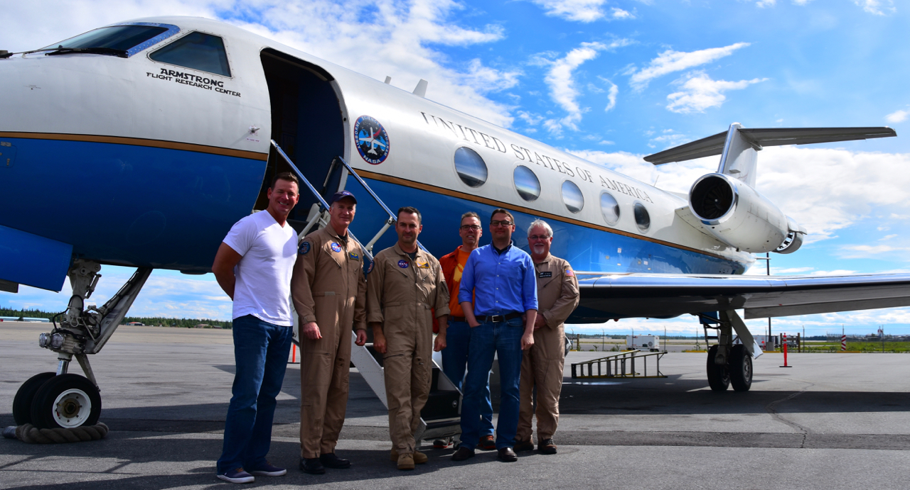
17 June 2017/DOY 168 Yukon – Kuskokwim Delta
Stevens Village
Beaver
The L-Team
Notes:
Yukon Delta NWR near Bethel, AK

Slide 9
17 June 2017/DOY 168 Yukon – Kuskokwim Delta
UAVSAR Quick-look products
A. Line 1, ID 19205: Lake Clark
B. Line 2, ID 32608: S River
Joanne Shimada, JPL
A
B
A. This swath covers multiple SWAN sites for soil moisture and vegetation ground truth
B. The S River line captures Interior Alaska forest

Slide 10
17 June 2017/DOY 168 Yukon – Kuskokwim Delta
UAVSAR Quick-look products
A. Line 3, ID 26905_002: YK Delta 1
B. Line 4, ID 26906_004: YK Delta 2
C. Line 5, ID 01813_005: YK Coast
Joanne Shimada, JPL
A
B
C
Notes:
A&B: these lines support multiple teams looking at the impact of the 2015 fires on tundra, carbon fluxes and wildlife. Ground penetrating radar measurements will be acquired over select ground sites here
C. UAVSAR imagery will help characterize coastal weltands and critical waterfowl areas of the YK Delta

Slide 11
17 June 2017/DOY 168 Yukon – Kuskokwim Delta
UAVSAR Quick-look products
A. Line 6, ID 04215_006: Innoko
B. Line 7, ID 08911_007: Poorman
Joanne Shimada, JPL
A
B
A. The Innoko wetlands produce some of the largest CO2 and CH4 fluxes in AK. Wetlands mapping a soil moisture characterization will help understand these dynamics.
B. Multiple clusters of tree ring sites provide ground truth for SAR forest remote sensing

Slide 12
17 June 2017/DOY 168 Yukon – Kuskokwim Delta
UAVSAR Quick-look products
A. Line 8, ID 09115: Denali
B. Line 9, ID 30204: Delta Junction
Joanne Shimada, JPL
A
B
A. This swath covers clusters of long-term ground sites in Denali National Park
B. Sampling in and around the NEON Delta Junction intensive observation area

Slide 13
17 June 2017/DOY 168 Yukon – Kuskokwim Delta
27031
27030
P-Band Composite
L-Band Composite
Notes:
L-band and P-band composites acquired over burned tundra in the YK Delta. P-band data acquired on 5/27/17
Note the wider L-band swaths and possible changes in soil moisture in the lower half of the frame compared to the May 27 acquisitions

Slide 14
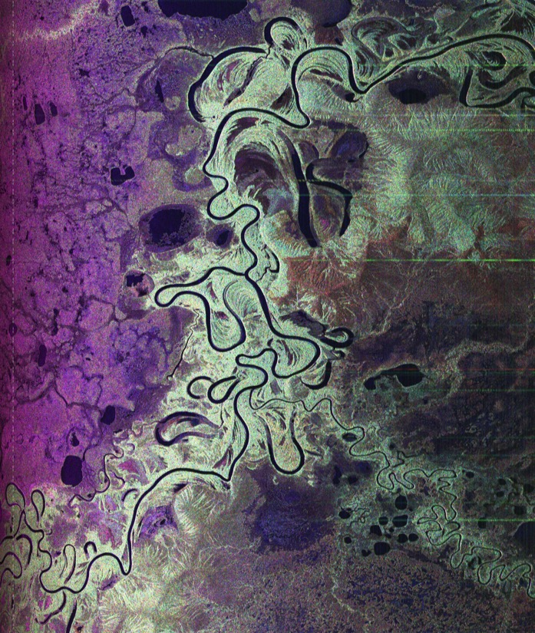
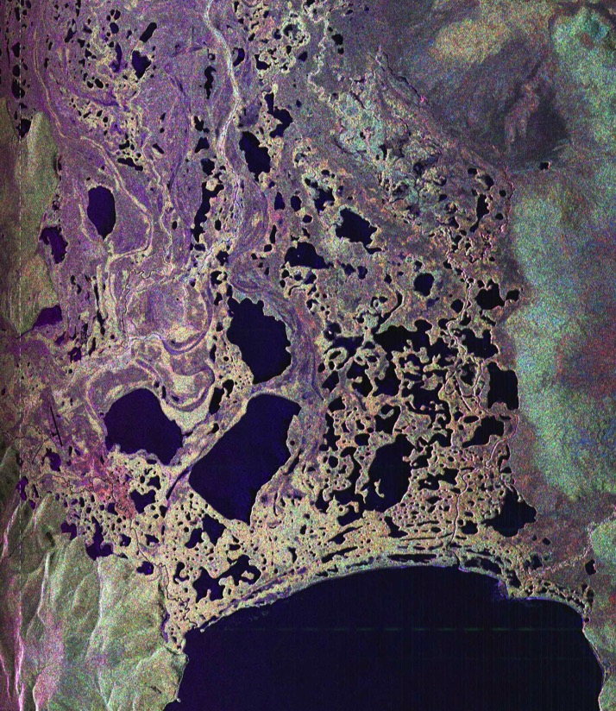
17 June 2017/DOY 168 Yukon – Kuskokwim Delta
Innoko
Delta Junction
Notes:
Detailed wetlands images from LEFT: the Innoko NWR and RIGHT: the Delta Junction area.
Innoko – the meandering Innoko River and its large numbers of oxbow lakes emphasize the very flat nature of this wetland complex
Delta Junction – an interconnected complex of small ponds and streams in the drainage basin of a larger lake

